Slide 1
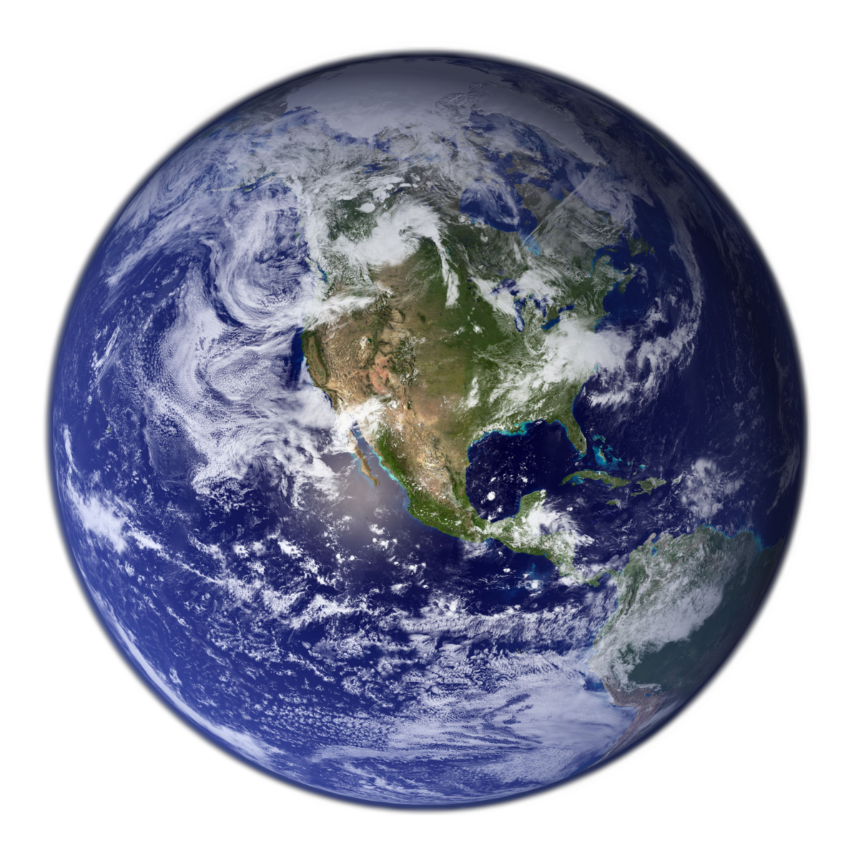



Hydrogen Production and Storage in Earth Mantle Minerals
Ava Campbell
Mentor: Dr. Sang-Heon Dan Shim
School of Earth and Space Exploration, ASU
AZSGC Statewide Symposium
19 April 2025
NASA Goddard Space Flight Center Image by Reto Stöckl

Slide 2
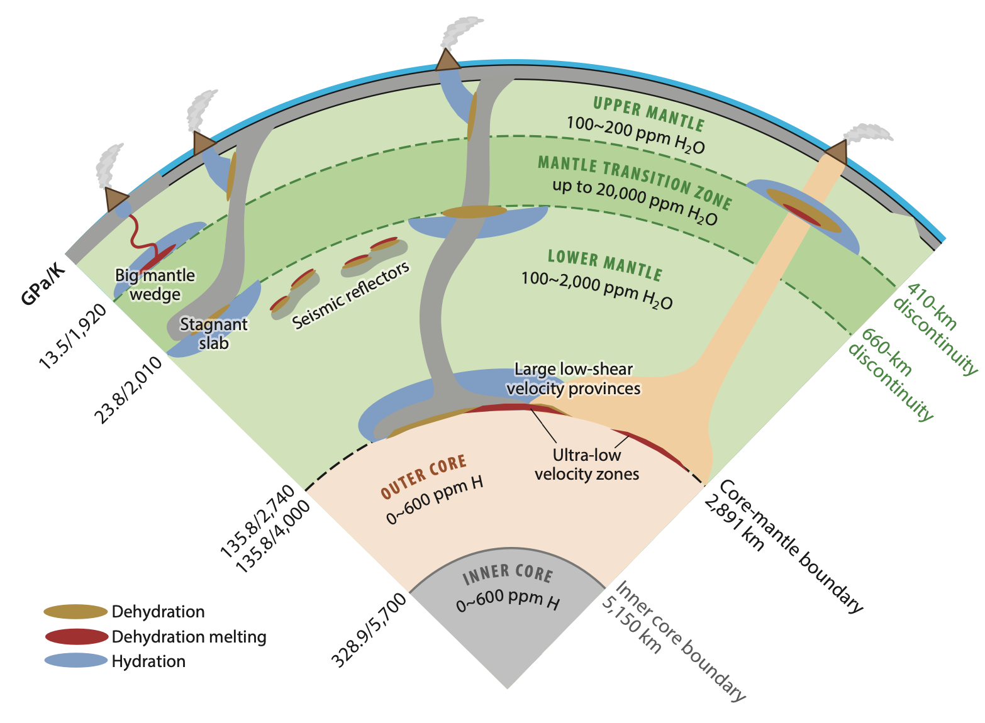

Objective
Determine P/T/time conditions for H₂ formation and storage in the upper mantle
(Ohtani 2020)

Slide 3
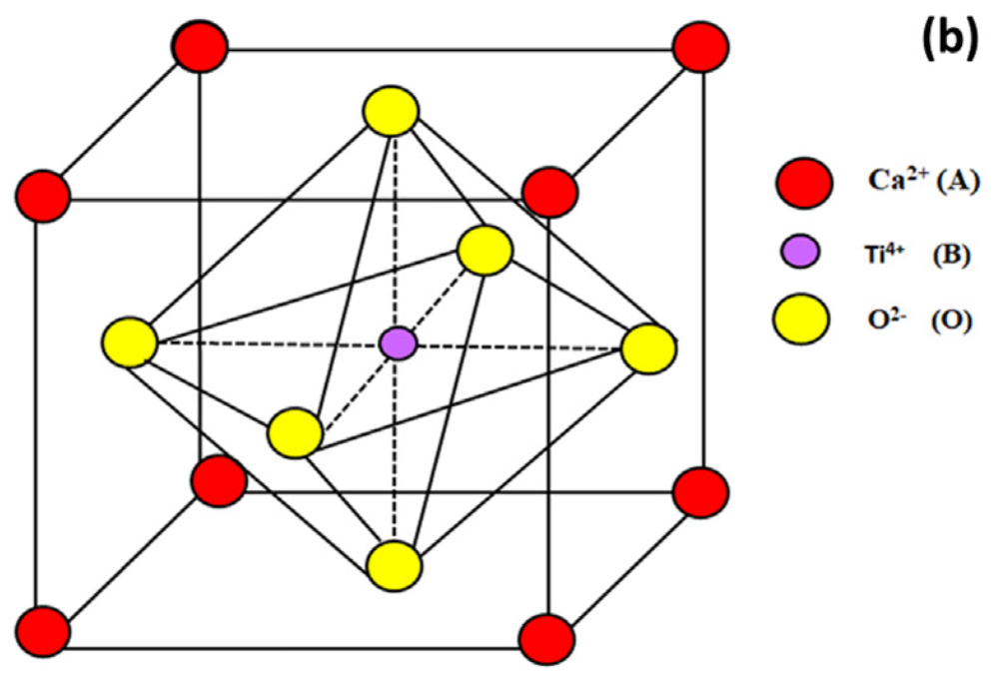
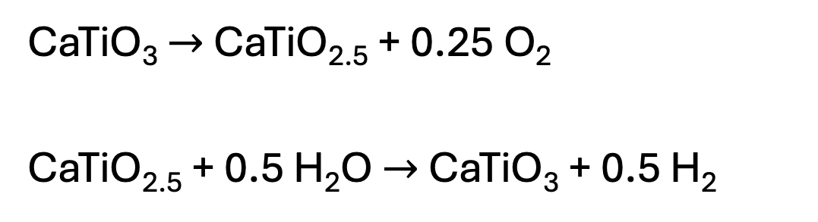

O ²⁻
H¹⁺
PT
$$∆$$
(Passi 2021)
CaTiO₃ $→$ CaTiO_{2.5} + 0.25 O₂
CaTiO_{2.5} + 0.5 H₂O $→$ CaTiO₃ + 0.5 H₂

Slide 4
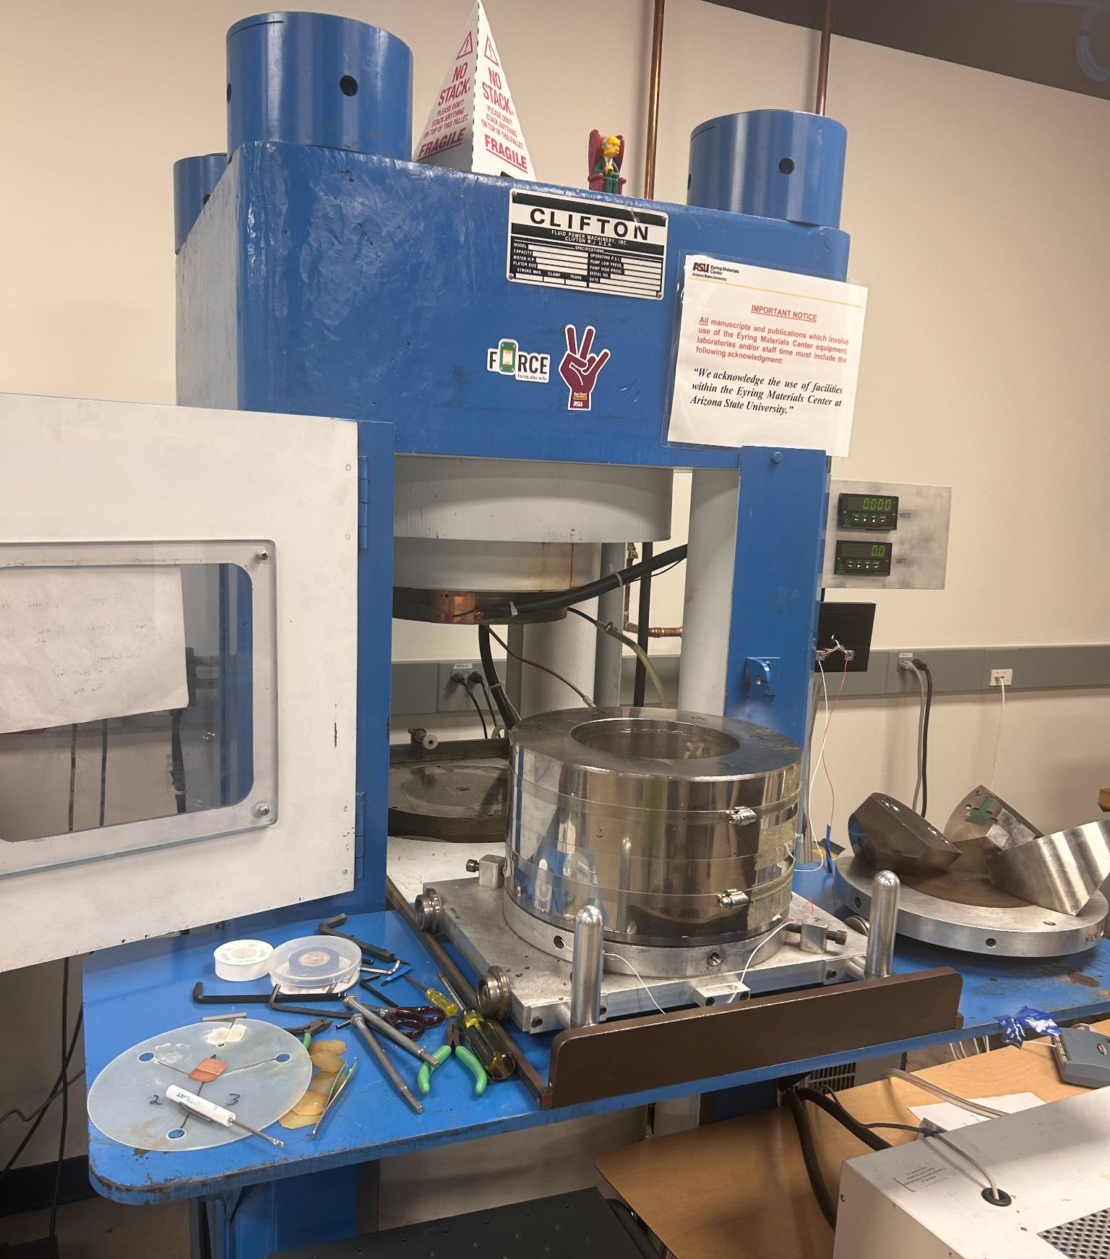
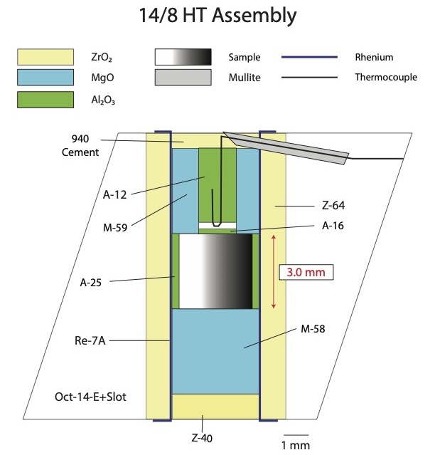
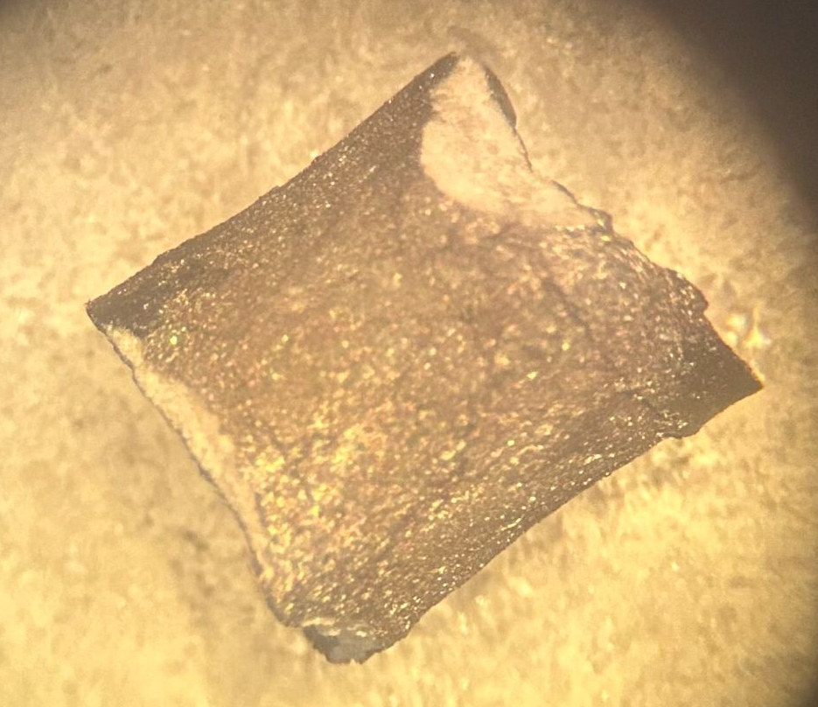
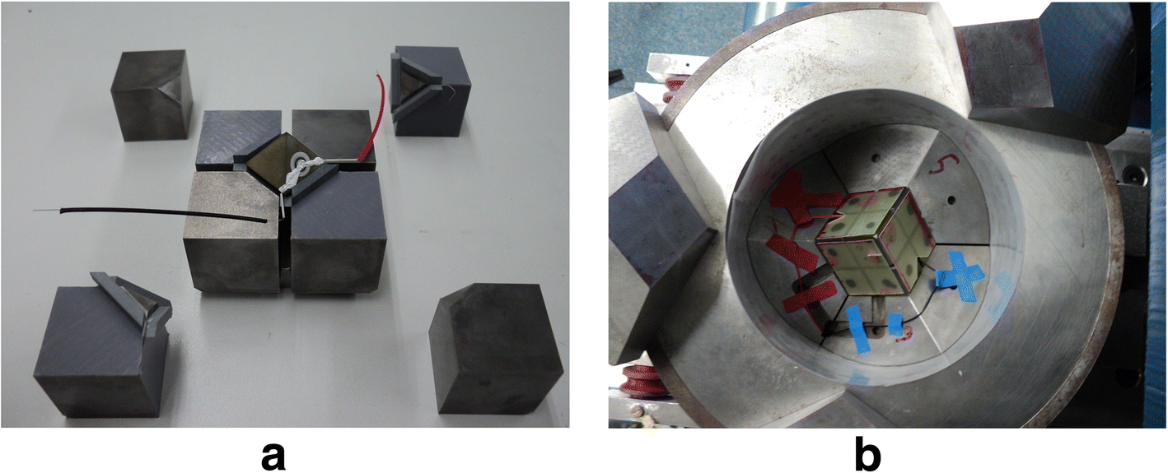
Method: Multi-Anvil Press
1mm
0.1 mm
FORCE’s ”Big Blue” 1000-ton press
(Knibbe 2018)
Notes:
Quick, 30 s, Pressure=Force/Area

Slide 5
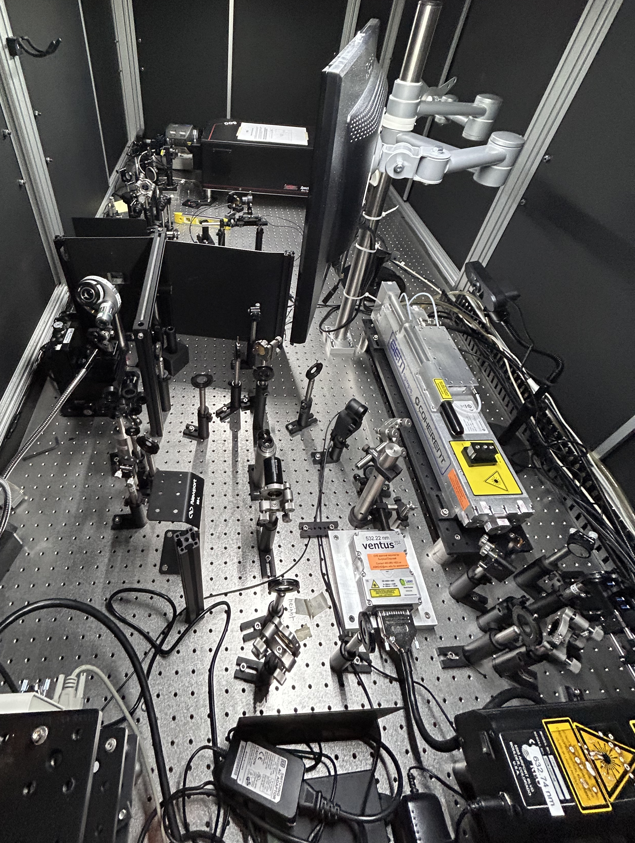
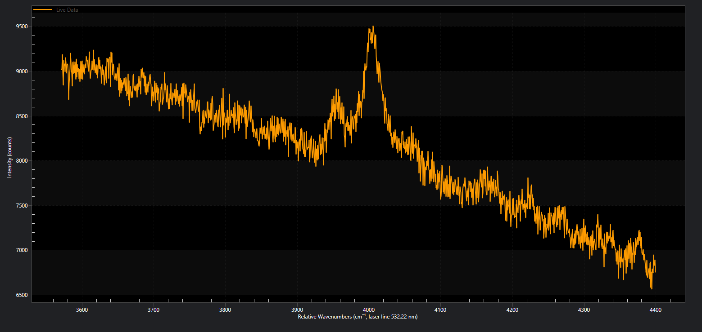

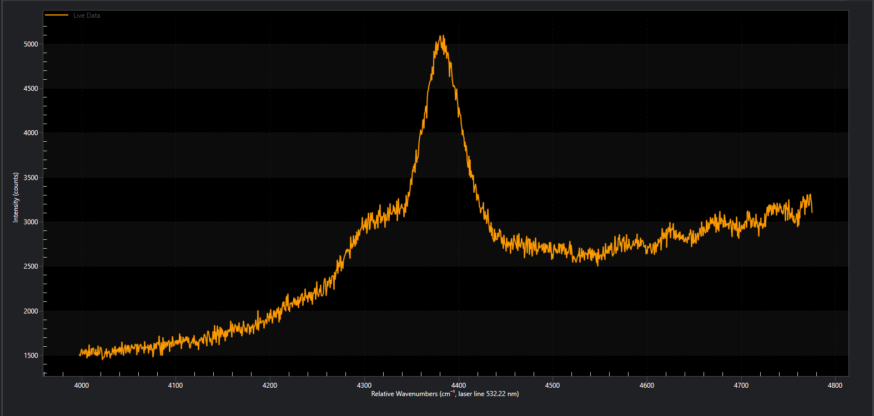
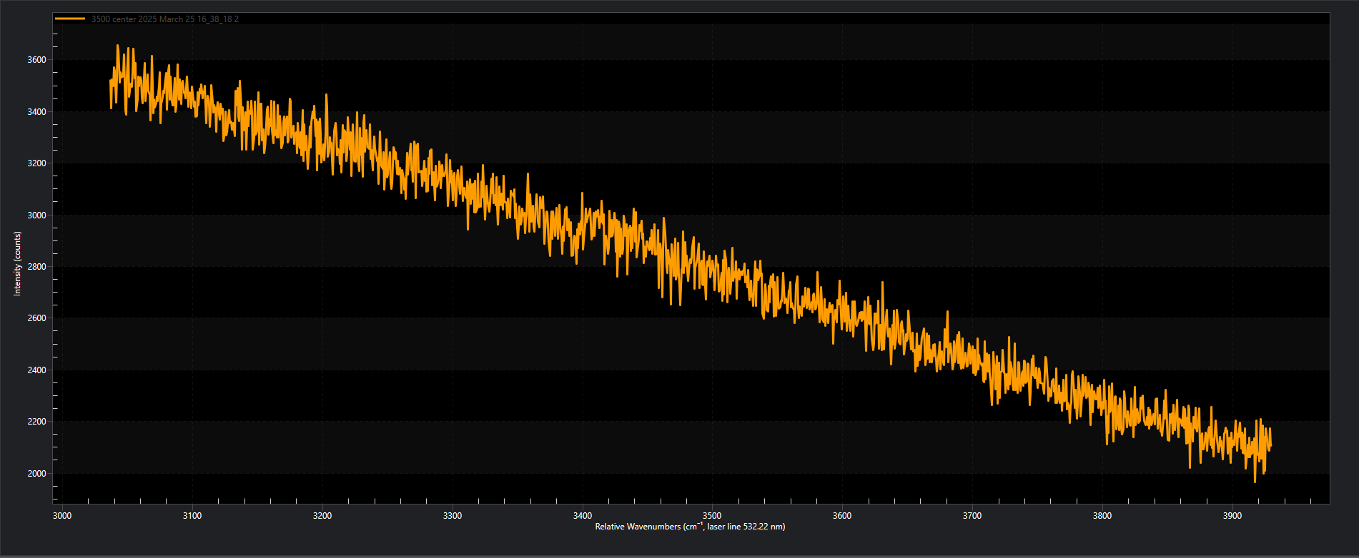
Analysis: Raman Spectroscopy
spectrometer
sample
laser
H-H is tiny!

Slide 6
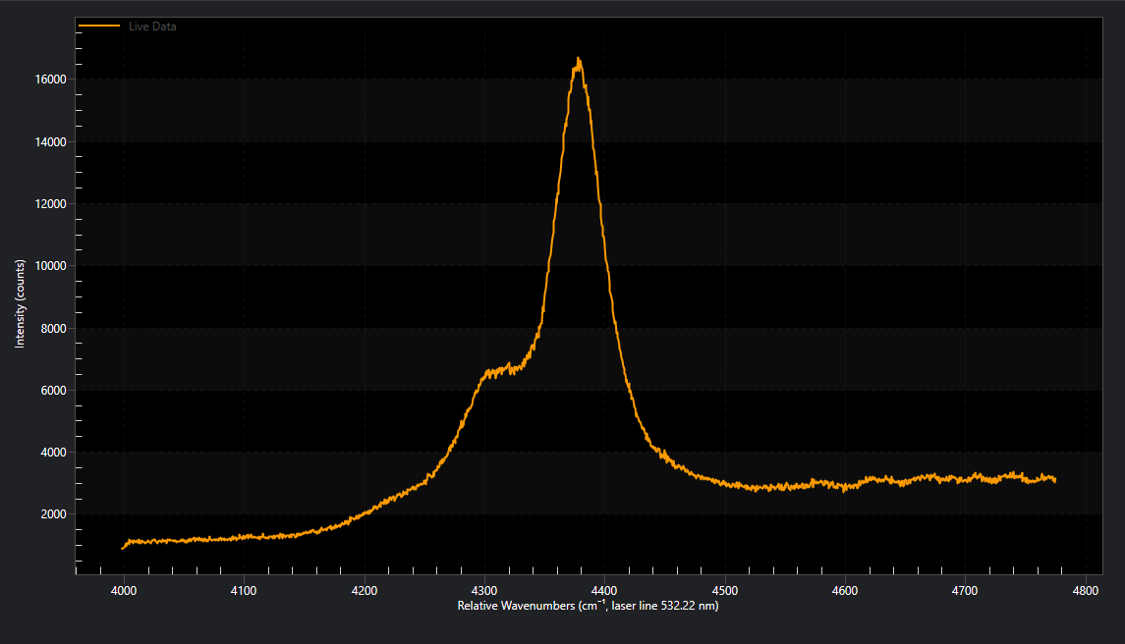
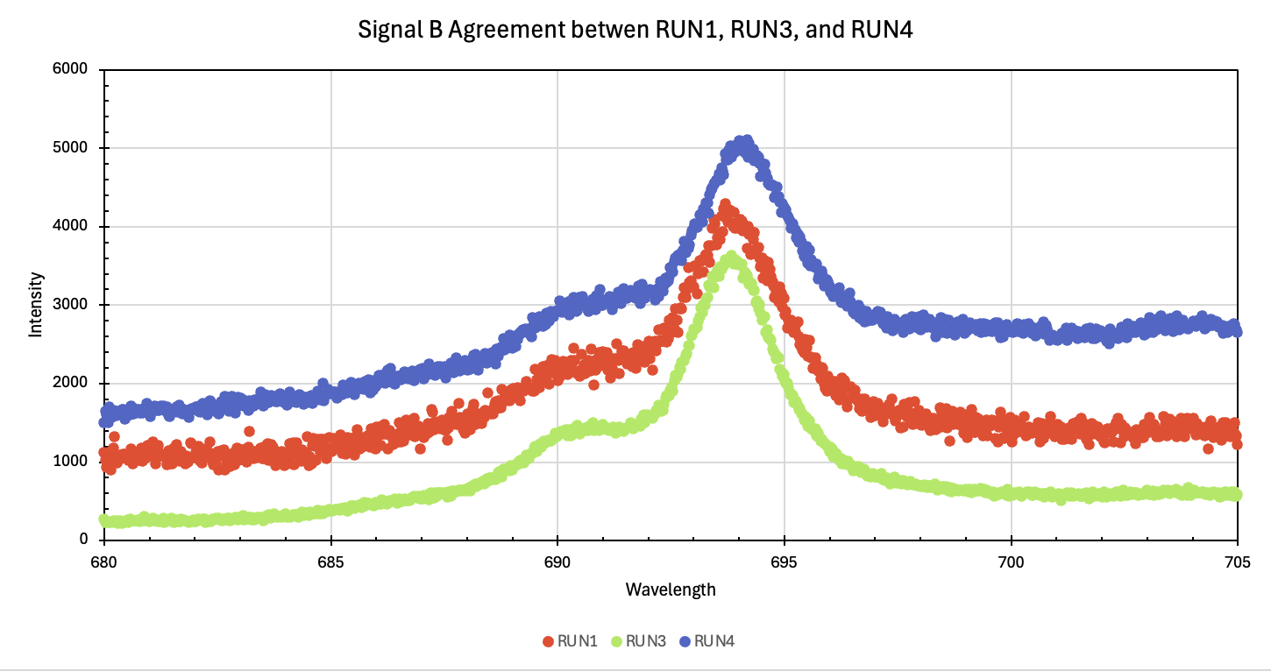
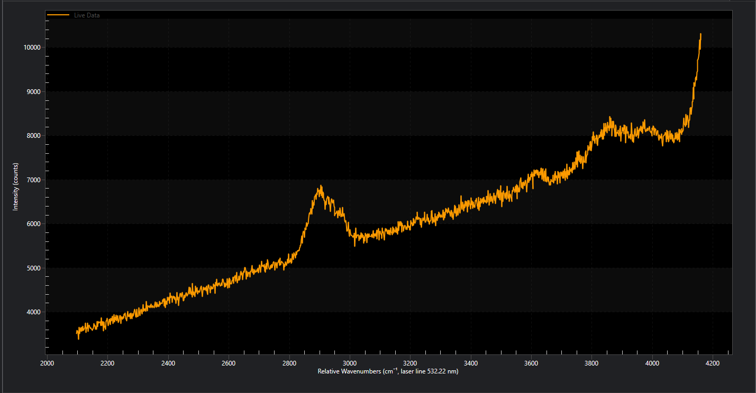
H-H?
Figure 1: (a) Low Pressure/High and Low Temperature/0.5-5Hrs (Signal B) and (b) Signal B agreements
H-H
H-H?
O-H
Figure 2: High Pressure/Low Temperature/8Hrs (Signal C)
Figure 3: known H-H peaks at Low Pressure/Low Temperature/8Hrs (Signal A)

Slide 7
Significance and Future Steps
Time
Peak Assignments
Quantification
NASA Goddard Space Flight Center Image by Reto Stöckl

Slide 8
Acknowledgements
Thank you to Dr. Dan Shim, Dr. Sibo Chen, and Dr. Taehyun Kim for their guidance, teaching, and expertise. Thank you to ASU’s FORCE lab for use of their high-pressure equipment and their LVP guidance. Thank you to ASU/NASA Space Grant for funding this project and providing me the opportunity to explore and share science!

Slide 9
Thank You

Slide 10
References
Knibbe, J.S., Luginbühl, S.M., Stoevelaar, R. et al. Calibration of a multi-anvil high-pressure apparatus to simulate planetary interior conditions. EPJ Techn Instrum 5, 5 (2018). https://doi.org/10.1140/epjti/s40485-018-0047-z
Ohtani, E. Hydration and dehydration in Earth’s interior. Annual Review of Earth and Planetary Sciences, 2021, 49, 253-278. DOI: https://doi.org/10.1146/annurev-earth-080320- 062509
Passi, Manjusha and Pal, Bonamali. A review on CaTiO3 photocatalyst: Activity enhancement methods and photocatalytic applications. Powder Technology, 2021, 274-304. https://doi.org/10.1016/j.powtec.2021.04.056

